Slide 1
網路概論實習課L13

Slide 2
Assume a datagram of size 5000 bytes crosses 5 different networks segments on its way from sender to receiver. The smallest MTU of all network segments is 820 bytes. a. In how many datagrams does the original datagram have to be fragmented in? b. At which point in the network does the fragmentation occur? c. Show the length, ID, fragflag, and offset fields of the IP header of each fragment. d. At which location are the IP fragments reassembled? Explain your answer
ANS:
a.7
b. The fragmentation occurs at the router directly ahead of the link with the MTU of 800 bytes

Slide 3
c.
1.Length = 820, ID = x, fragflag = 1, offset = 0;
2. Length = 820, ID = x, fragflag = 1, offset = 100;
3. Length = 820, ID = x, fragflag = 1, offset = 200;
4. Length = 820, ID = x, fragflag = 1, offset = 300;
5. Length = 820, ID = x, fragflag = 1, offset = 400;
6. Length = 820, ID = x, fragflag = 1, offset = 500;
7. Length = 200, ID = x, fragflag = 0, offset = 600;
d. All fragments are reassembled at the receiving host.

Slide 4
P12.Consider the topology shown in Figure4.20.Denote the three subnets with hosts(starting clockwise at 12:00)as Network A,B,C. Denote the subnets without hosts as Network D,E,F.
a. Assign network addresses to each of these six subnets , with the following constraints: All addresses must be allocated from 214.97.254/23:subnet A should have enough addresses to support 250 interfaces; Subnet B should have enough addresses to support 120 interfaces; and Subnet C should have enough addresses to support 120 interfaces. Of course , subnets D,E and F should each be able to support two interfaces . For each subnet , the assignment should take the from a.b.c.d/x or a.b.c.d/x –e.f.g.h/y
b. Using your answer to part (a) , provide the forwarding tables (using longest prefix matching)for each of the three routers

Slide 5
214.97.254/23
A 250 B 120 C 120 D 2 E 2 F 2
A
R1
ANS:
Subnet A: 214.97.255/24 (256 addresses)
Subnet B: 214.97.254.0/25 - 214.97.254.0/29 (128-8 = 120 addresses 扣掉分給DEF的)
Subnet C: 214.97.254.128/25 (128 addresses)
Subnet D: 214.97.254.0/31 (2 addresses)
Subnet E: 214.97.254.2/31 (2 addresses)
Subnet F: 214.97.254.4/30 (4 addresses)
F
D
R2
R3
E
C
B

Slide 6
b.
ANS:
R1 11010110 01100001 11111111 Subnet A
11010110 01100001 11111110 0000000 Subnet D
11010110 01100001 11111110 000001 Subnet F
R2 11010110 01100001 11111111 000001 Subnet F
11010110 01100001 11111110 0000001 Subnet E
11010110 01100001 11111110 1 Subnet C
R3 11010110 01100001 11111111 0000000 Subnet D
11010110 01100001 11111110 0 Subnet B
11010110 01100001 11111110 0000001 Subnet E

Slide 7
P19.Consider the SDN OpenFlow network shown in Figure 4.30 . Suppose that the desired forwarding behavior for datagrams arrive at s2 is as follows :
1. any datagrams arriving on input port 1 from hosts h5 or h6 that are destined to host h1 or h2 should be forwarded over output port2 2. any datagrams arriving on input port 2 from hosts h1 or h2 that are destined to host h5 or h6 should be forwarded over output port2 3. any datagrams arriving on input port 1 from hosts h5 or h6 that are destined to host h3 or h4 should be delivered to the host specified 4. host h3 and h4 should be able to send datagrams to each other

Slide 8
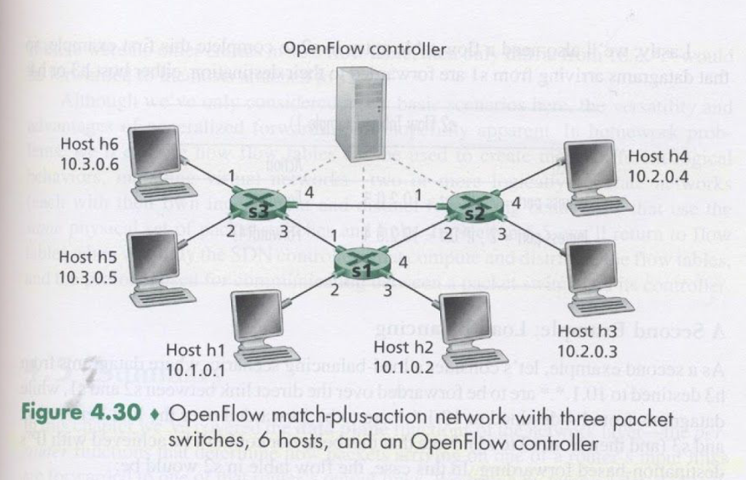
1.Port 1 h5,h6 -> h1,h2 over port2
2.Port2 h1,h2->h5,h6 over port1
3.Port 1,2 any host->h3,h4
4.h3->h4 , h4->h3

Slide 9
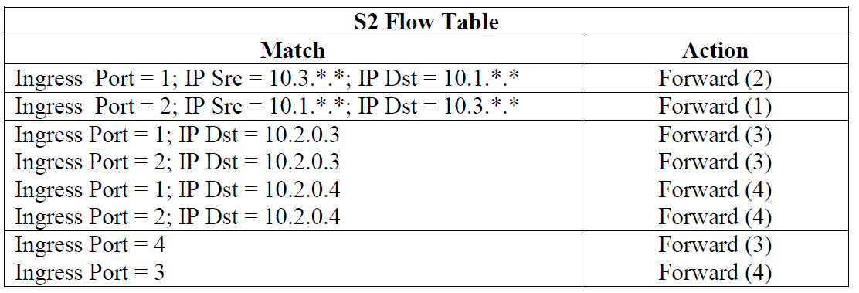

Slide 10
作業上傳
https://drive.google.com/drive/folders/1Z3G0i5IRIQER-OQm6AWrAnDYd_zsWCGe?usp=sharing
https://goo.gl/9we7gy

